Slide 1
End of sprint presentation
4
R.Visser, K.Notebomer & S.Bouwman

Slide 2
Main goal
Create a ML model that assists in the annotation process of electron microscopy data by learning on minimal annotation.
1

Slide 3
Sprint goals
Improving neural networks
1
Improve SVM
2

Slide 4
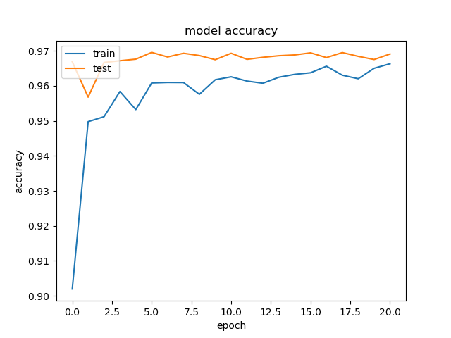
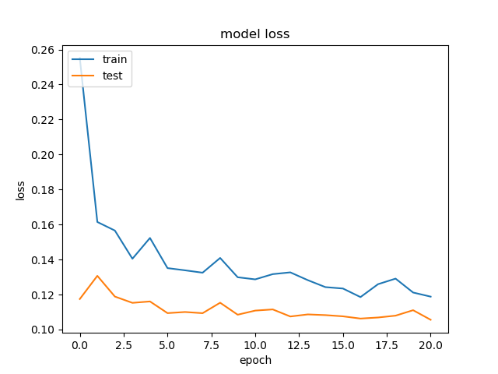
Neural network
Optimal model

Slide 5
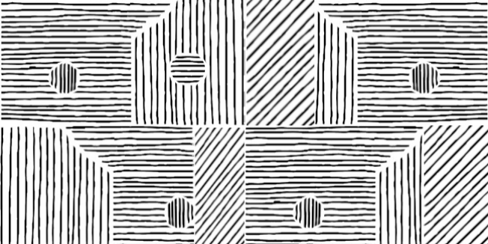
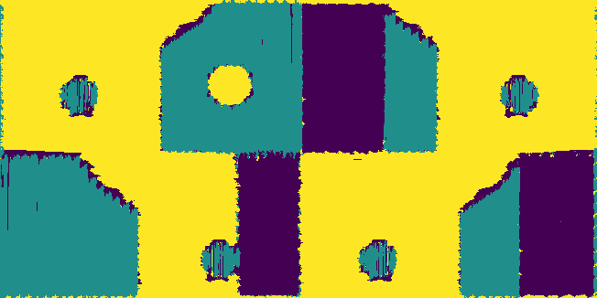


Striped dataset
Input

Slide 6
SVM
Input

Slide 7
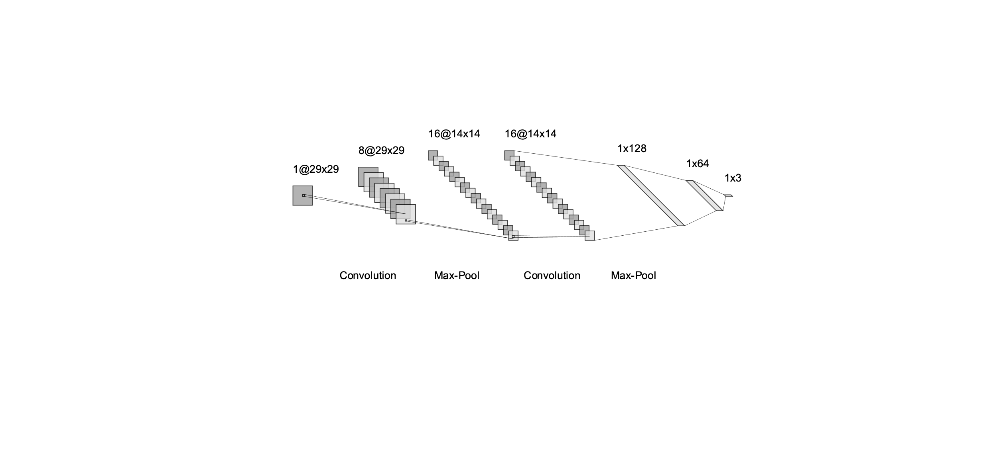
Bastet
Model

Slide 8
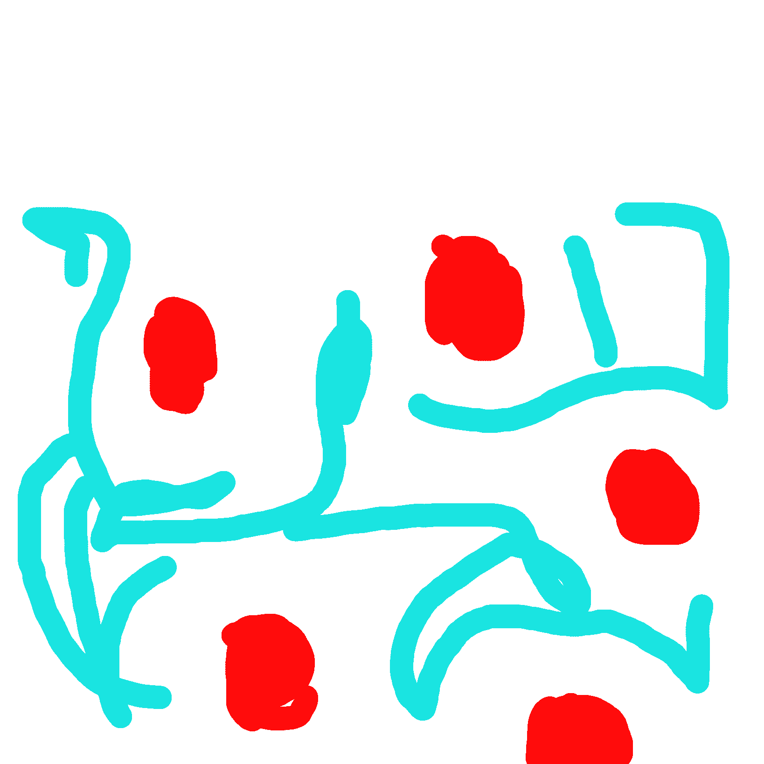
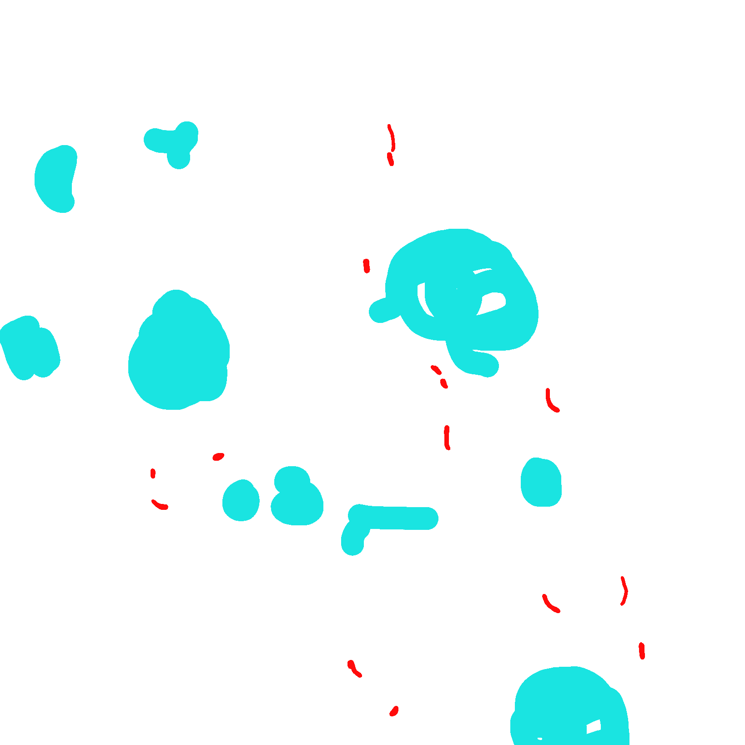
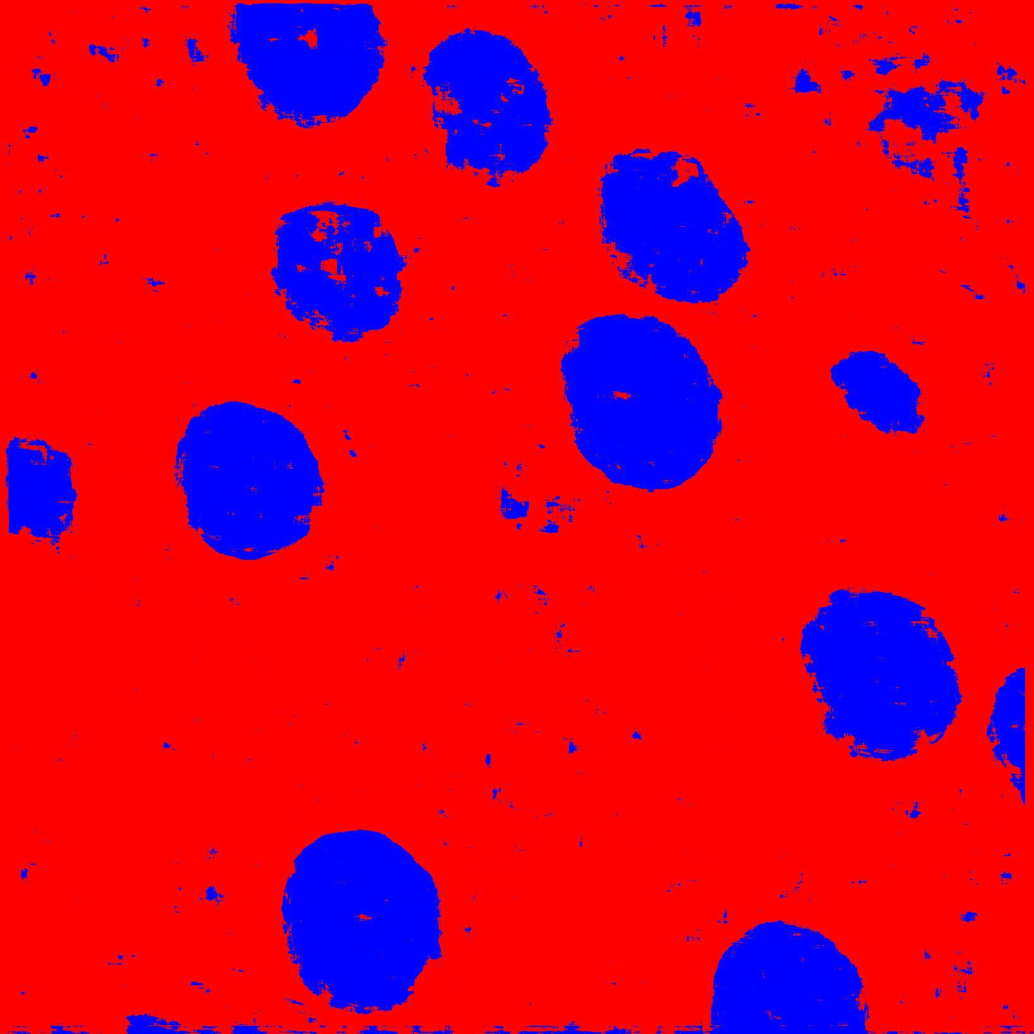
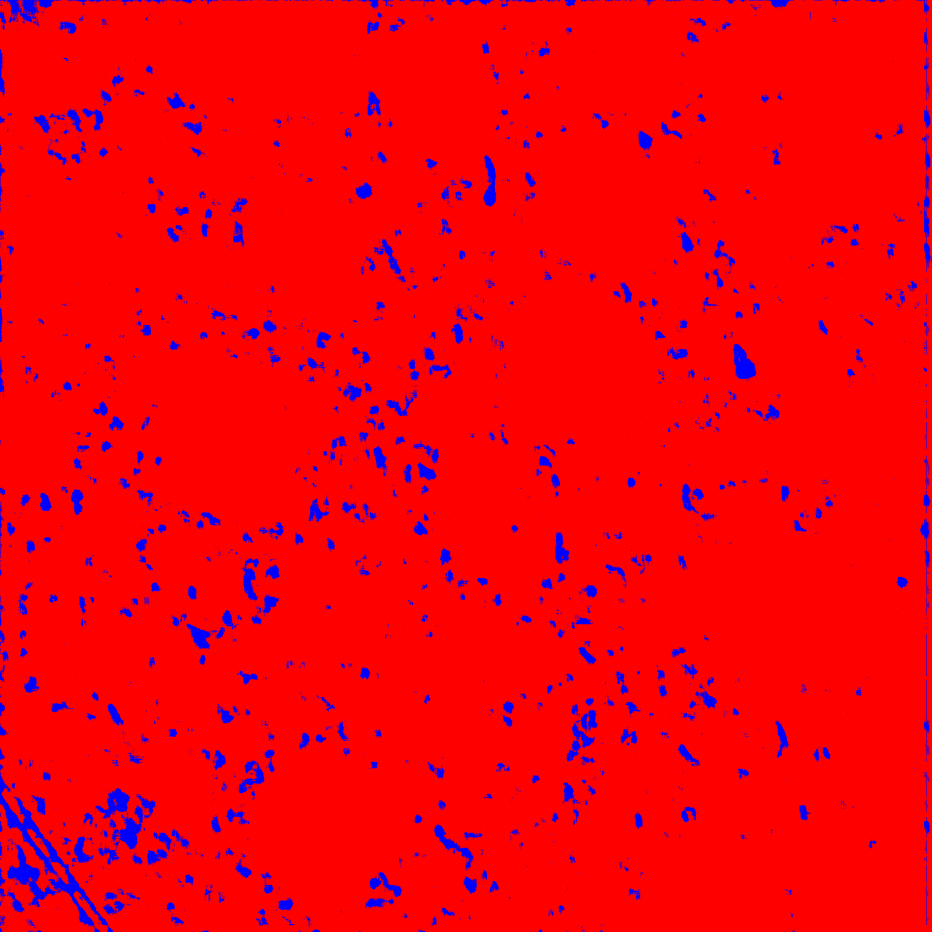
Bastet
Input

Slide 9
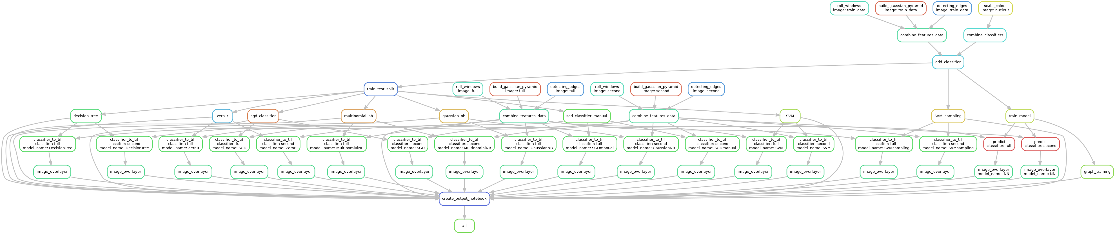
Finished Pipeline
Optimal model

Slide 10

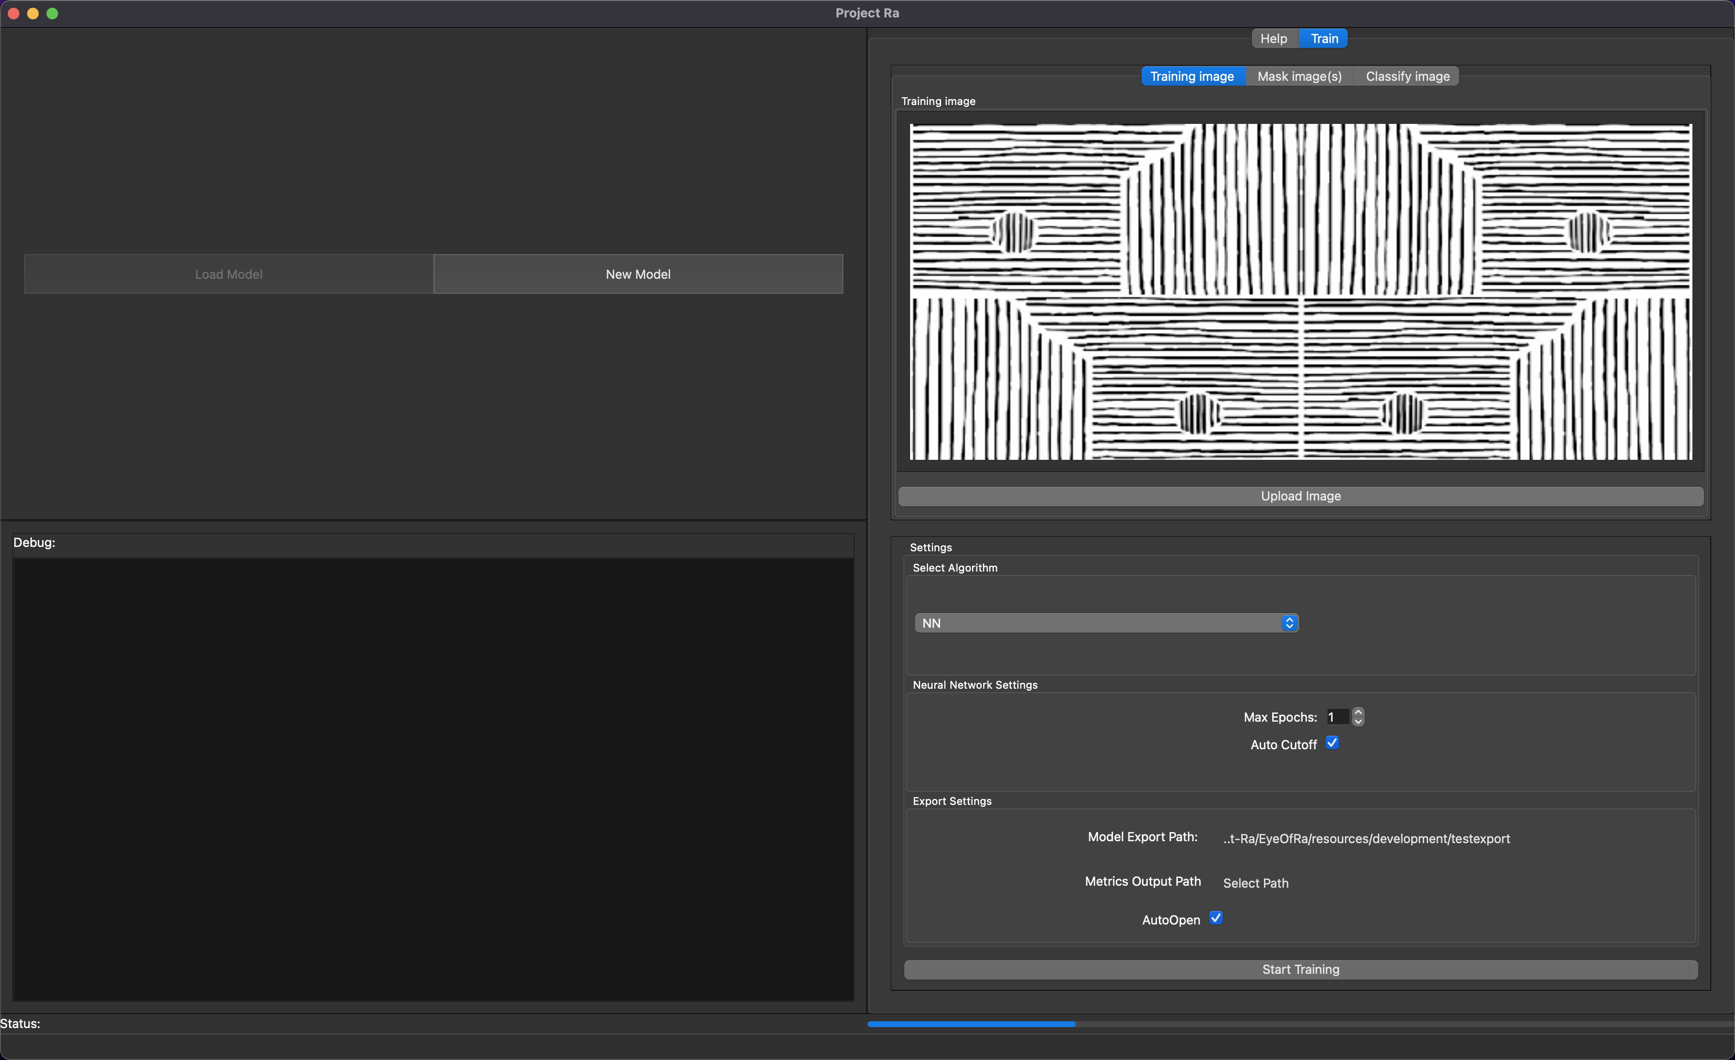
Interface (Qt)
Demo

Slide 11
Interface
Future and difficulties
Make fully functional
Bugfixes
Provide user feedback
Write help page
More flexible
Better formatted code
Annotation tool

Slide 12
Conclusion
Overall performance of convolutional neural networks outclass regular machine learning algorithms significantly in accuarcy, speed of training/classification and ease of implementation.
The original goal of this project seems to be too complex to solve in half a year with both limited knowledge and resources (GPU’s).

Slide 13
FIN

